Slide 1


Social Value Building Futures East's COVID Response
Making a difference in difficult times

Slide 2
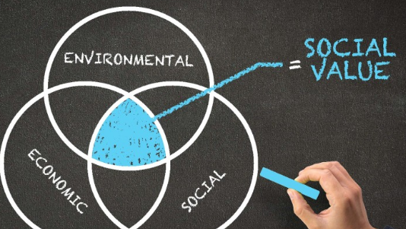
What is Social Value?

Slide 3

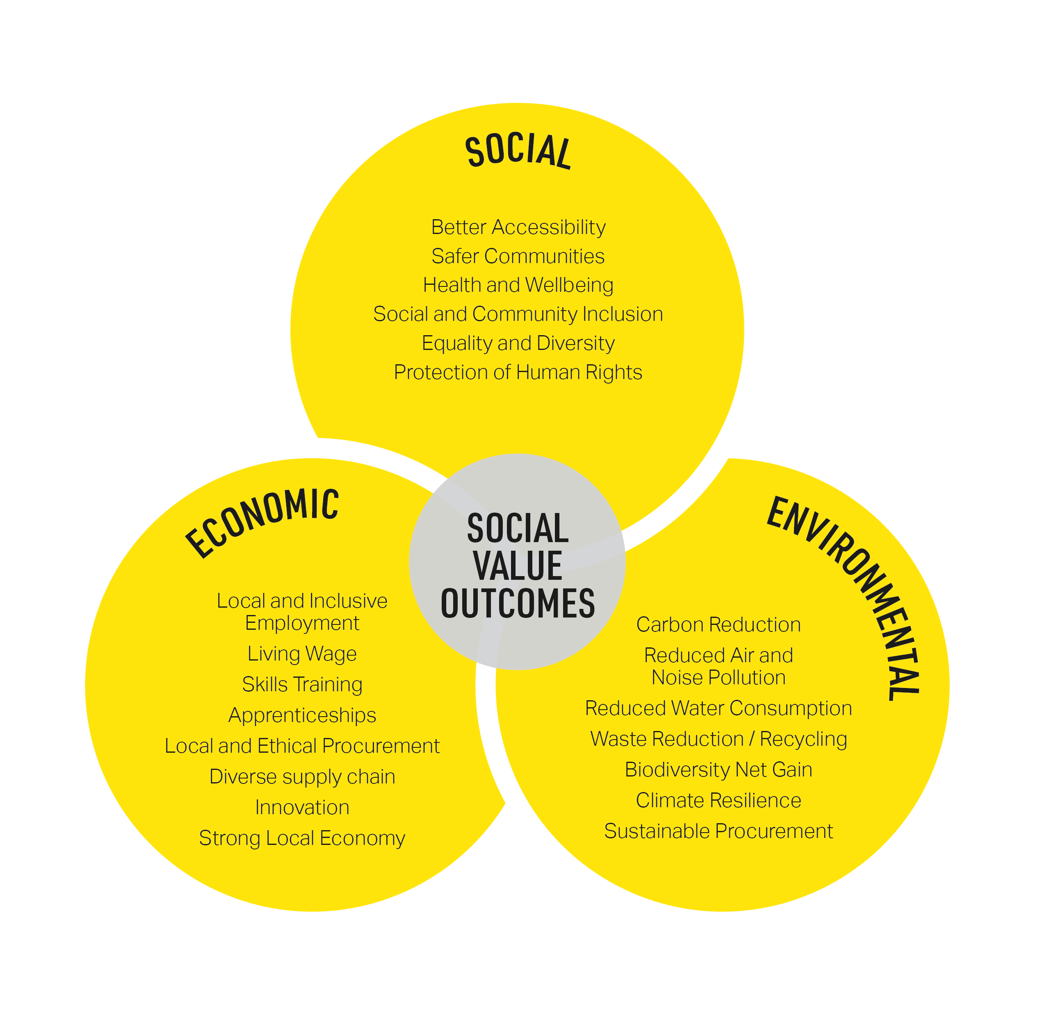
Benefits
Why add Social Value?

Slide 4

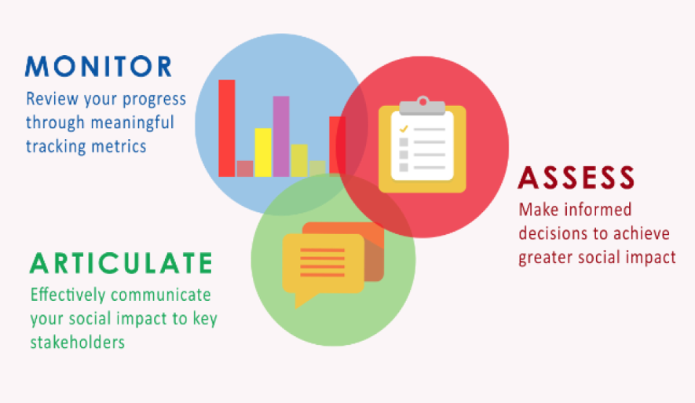
Why measure Social Value?

Slide 5


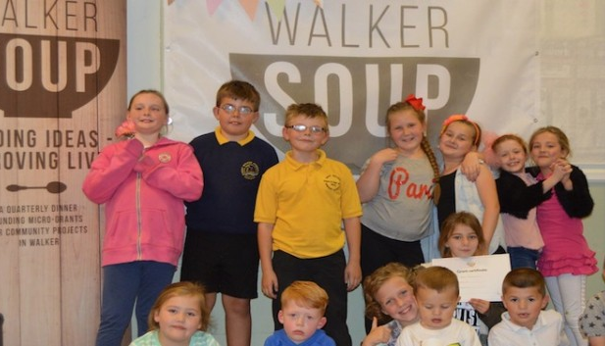


Established in 2006
Achieved charitable Status in 2008 with Building Futures now acting as sub-subsidiary
Based in Walker
Focus on social enterprise and vocational skills training
Offers Employment, Vocational and personal development training
Supports individuals from disadvantaged communities in Newcastle and sub-region
In partnership with Newcastle city council, TyneMet College, as well as other schools and businesses
Runs local programmes aimed at regeneration such as Walker Soup, East End Women and others

Slide 6
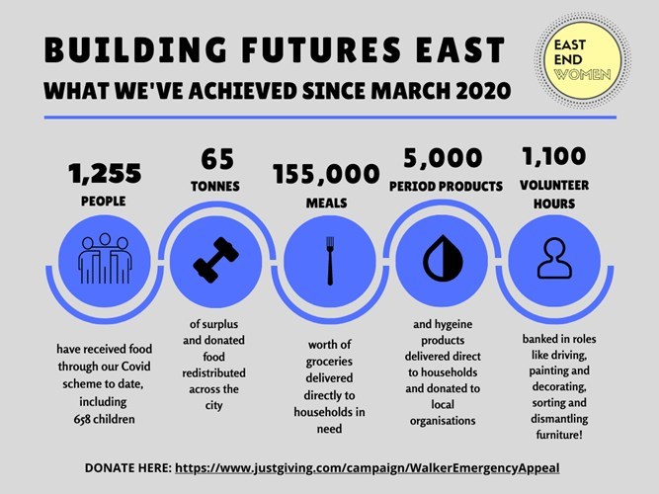
COVID RESPONSE
Since March 2020 Building Futures East has continued its work in the face of the pandemic publishing these statistics to help spread awareness and support through donations and volunteering

Slide 7
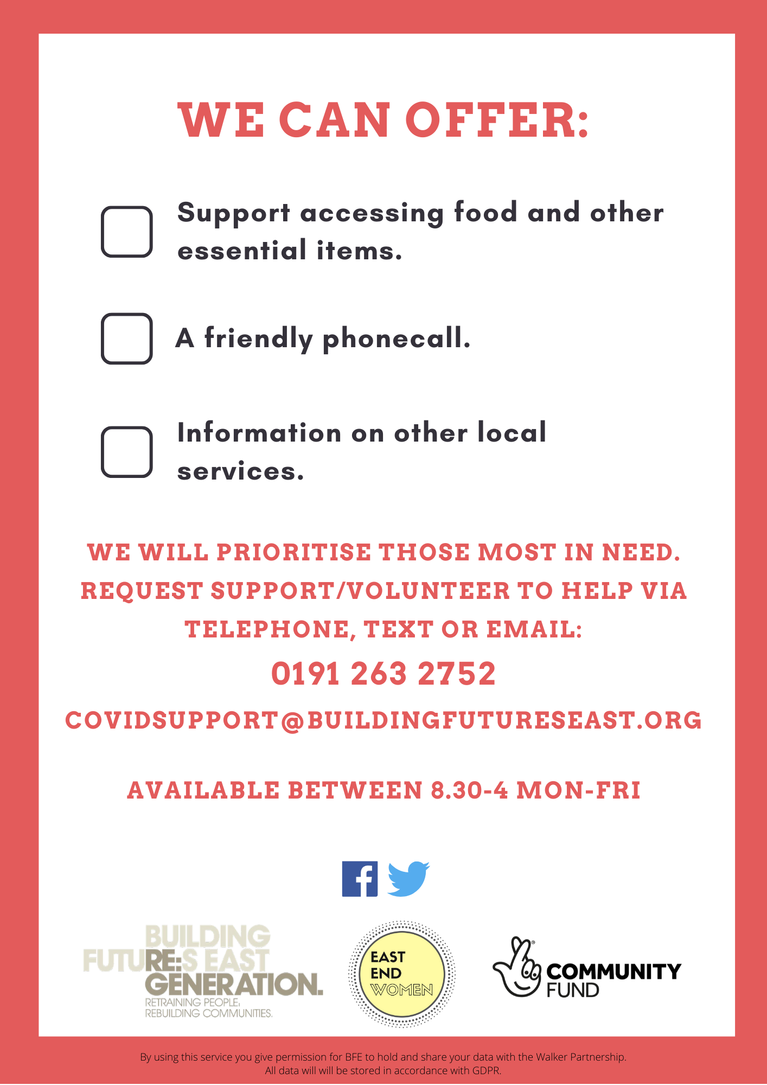
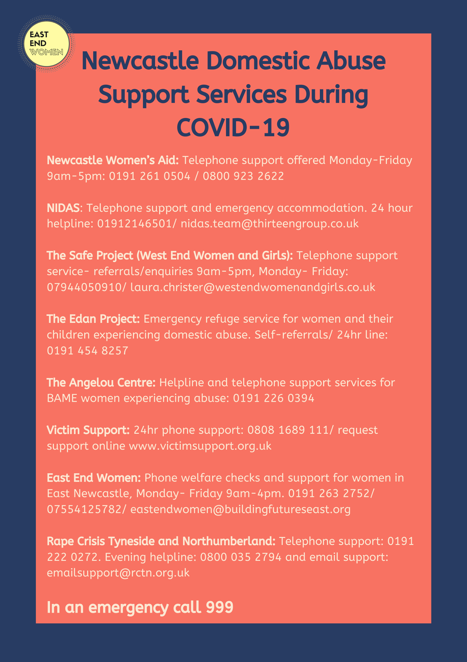

Giving more than just food.....

Slide 8

“Social accounting (also known as social accounting and auditing, social and environmental accounting, corporate social reporting, corporate social responsibility reporting, non-financial reporting or accounting) is the process of communicating the social and environmental effects of organizations’ economic actions to particular interest groups within society and to society at large” (Killian & O'Regan, 2016).

Slide 9

"Social Return on investment is a simple financial assessment of socio-economic value. SROI compares project's net benefits to the investment required to generate those benefits over a certain period of time." (Emerson & Cabaj, 2000)

Slide 10
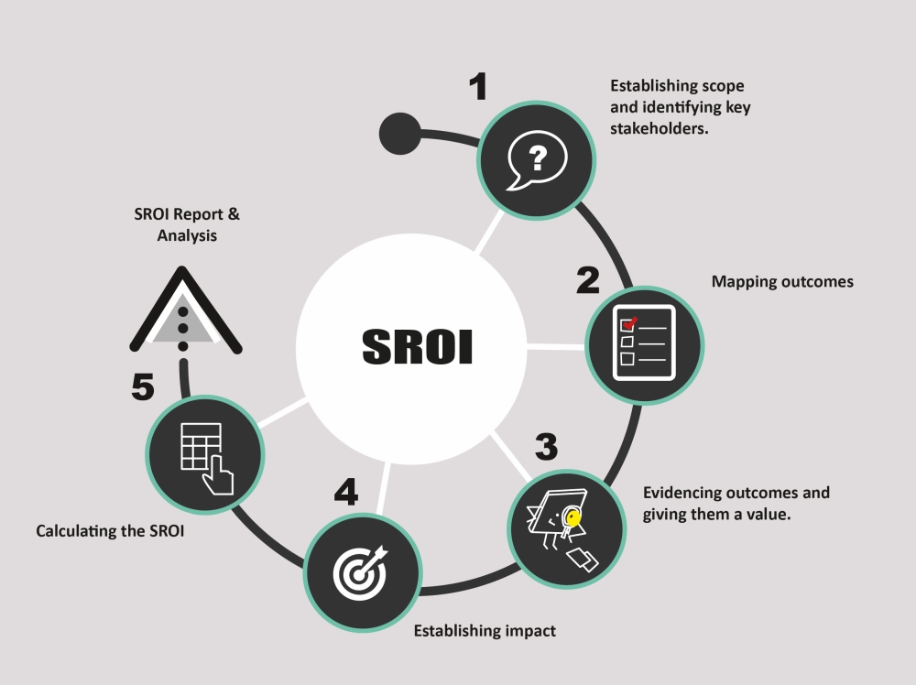
5 Stages of Implementing Social Return on Investment
Our Recommendation

Slide 11
